Slide 1



Great Datasets: A Story
Alex Cookson
@alexcookson
tacookson
_

Slide 2
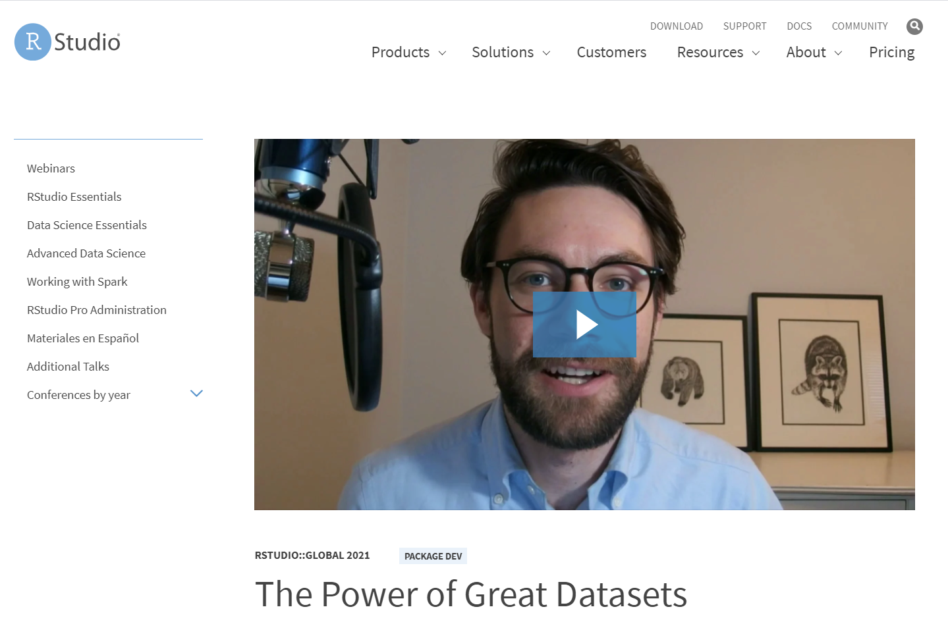
Bored? Busy?
Watch the 5-minute version of this talk

Slide 3
How do love stories usually go?

Slide 4
Non-binary person meets Boy
Non-binary person meets Girl
Girl meets Girl
Boy meets Girl
Girl meets Boy
Boy meets Boy
Non-binary person meets Non-binary person

Slide 5
Non-binary person meets Boy
Non-binary person meets Girl
Girl meets Girl
Boy meets Girl
Girl meets Boy
Boy meets Boy
Non-binary person meets Non-binary person
Learner meets Data

Slide 6
Ever seen a romantic comedy?

Slide 7
Ever seen a romantic comedy?
The Meeting

Slide 8
Ever seen a romantic comedy?
The Meeting
Sparks Fly

Slide 9
Ever seen a romantic comedy?
The Meeting
Sparks Fly
Tension / Crisis

Slide 10
Ever seen a romantic comedy?
The Meeting
Sparks Fly
Tension / Crisis
Falling In Love

Slide 11

The Meeting: Hamilton
Hamilton tickets for Christmas!
My brother the Broadway fan
Weekly grosses: tickets sales, ticket prices, percent of seats sold – all the way back to 1985

Slide 12

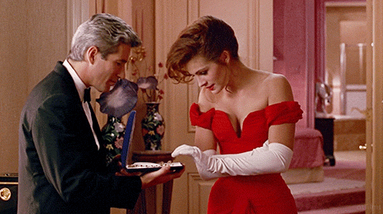
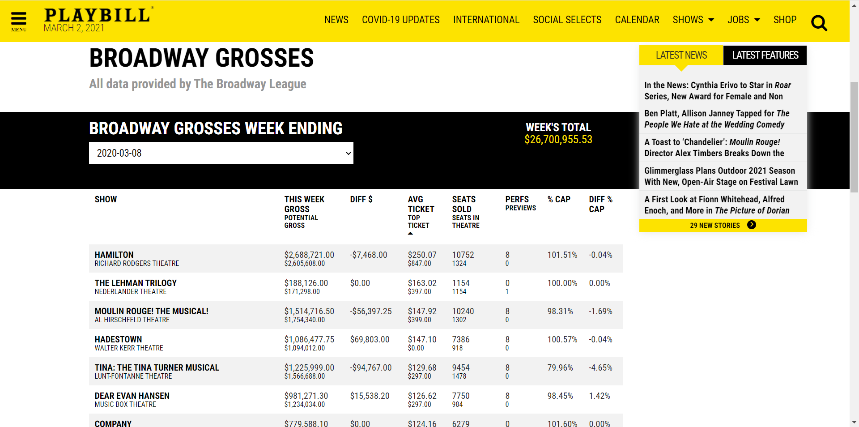
Sparks Fly: Weekly Grosses on Playbill

Slide 13
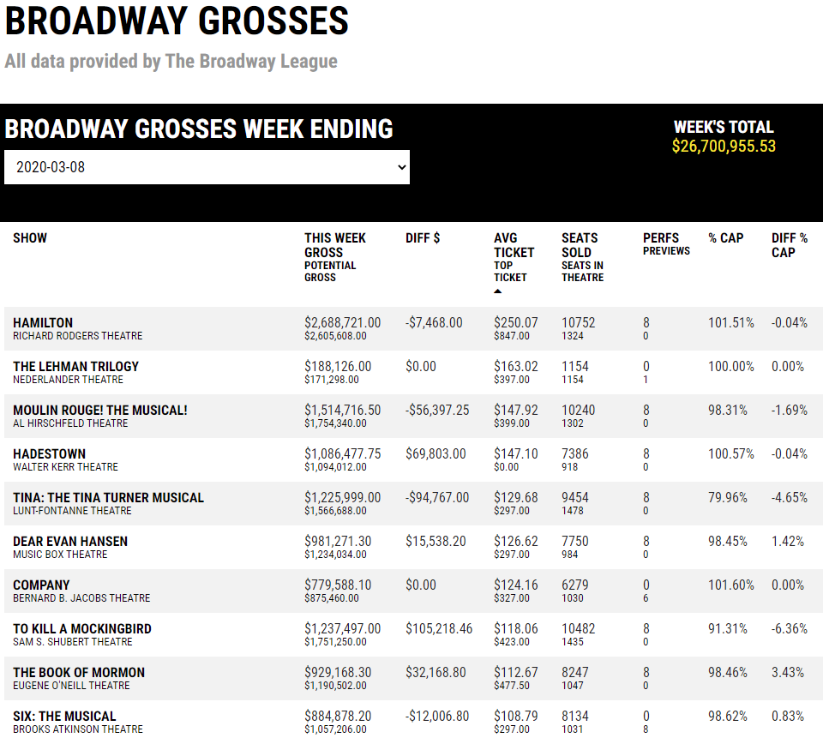

Slide 14
Are Hamilton tickets on Broadway really that expensive?

Slide 15
Yes! $250 (USD) a pop!
($850 if you’re fancy)

Slide 16
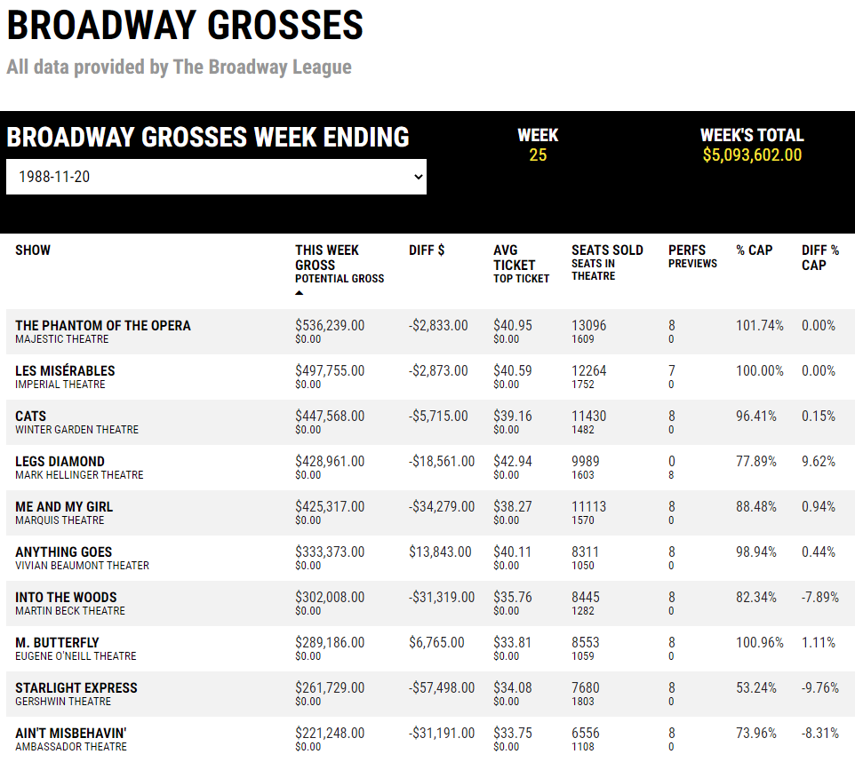
What was popular the week I was born?

Slide 17
Phantom, Les Mis, and Cats!

Slide 18
What’s the highest-grossing show EVER?

Slide 19
What’s the highest-grossing show EVER?
Have average ticket prices gotten more expensive?

Slide 20
Is there any seasonality to ticket prices?
What’s the highest-grossing show EVER?
Have average ticket prices gotten more expensive?

Slide 21
Is there any seasonality to ticket prices?
Do revivals perform as well as their originals?
What’s the highest-grossing show EVER?
Have average ticket prices gotten more expensive?

Slide 22
Is there any seasonality to ticket prices?
Is Hamilton’s success unprecedented?
Do revivals perform as well as their originals?
What’s the highest-grossing show EVER?
Have average ticket prices gotten more expensive?

Slide 23
Is there any seasonality to ticket prices?
???
Is Hamilton’s success unprecedented?
Do revivals perform as well as their originals?
What’s the highest-grossing show EVER?
Have average ticket prices gotten more expensive?

Slide 24

Tension / Crisis: Stuck!
I didn’t want data (one week at a time) – I wanted DATA
The data was right there, but I couldn’t get to it

Slide 25

Tension / Crisis: Stuck!
Should I learn how to web scrape?

Slide 26
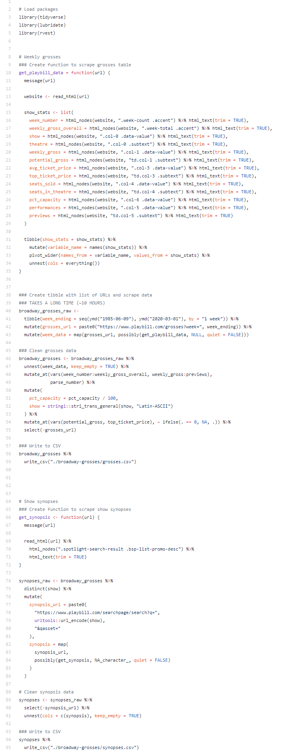
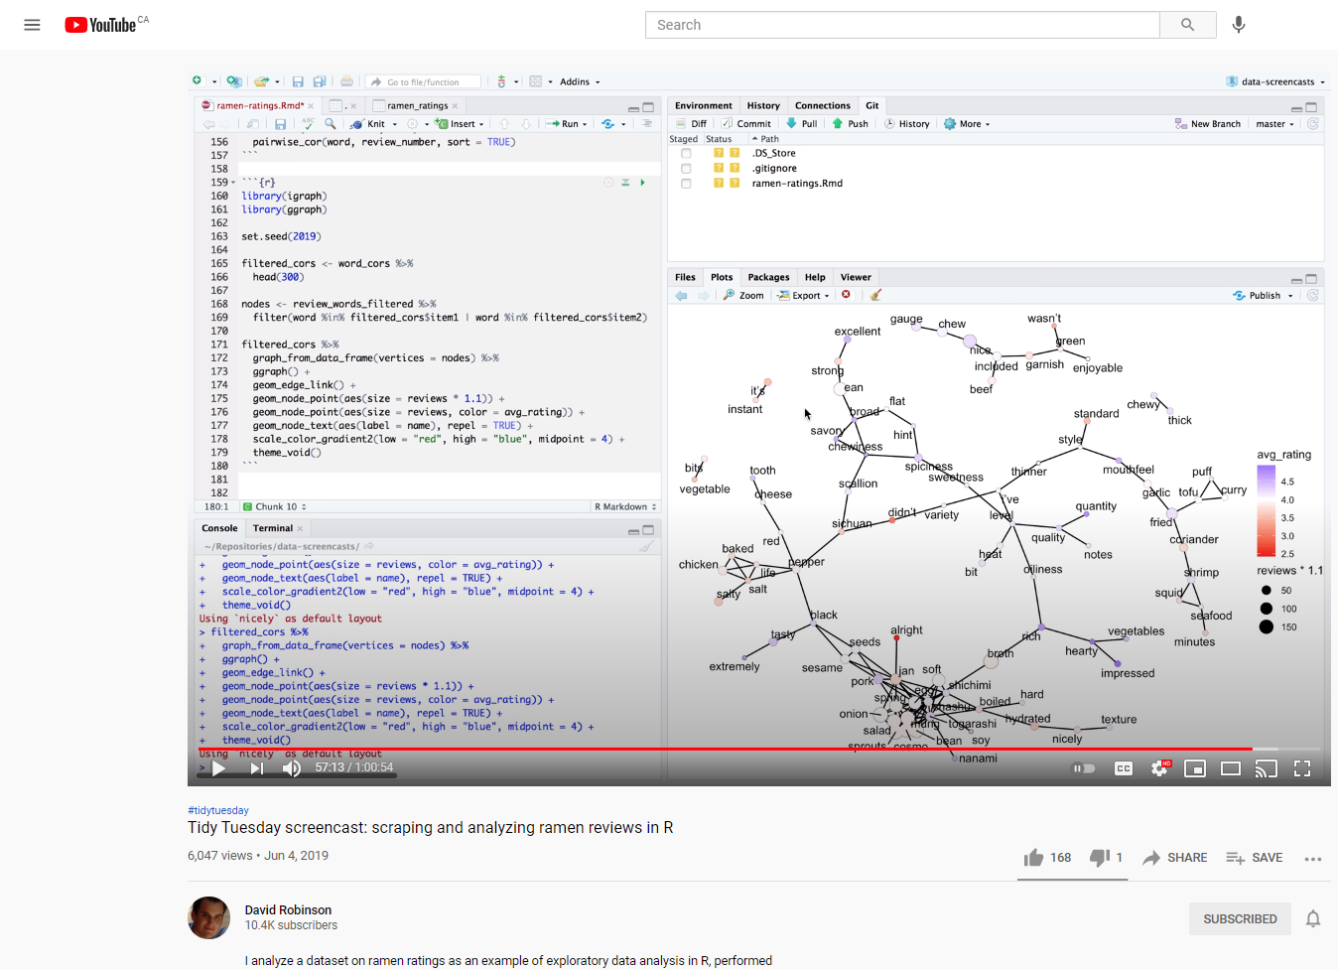

Tension / Crisis: Stuck!
+
=

Slide 27
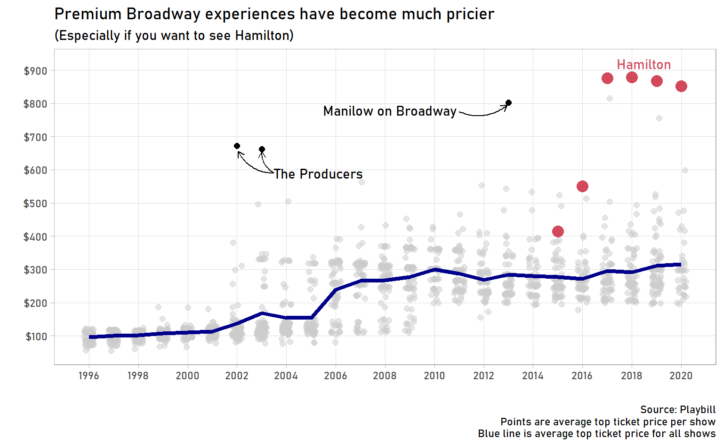
Falling In Love
Is Hamilton’s success unprecedented?

Slide 28
Falling In Love
No! The Producers was the Hamilton of its day
Is Hamilton’s success unprecedented?

Slide 29
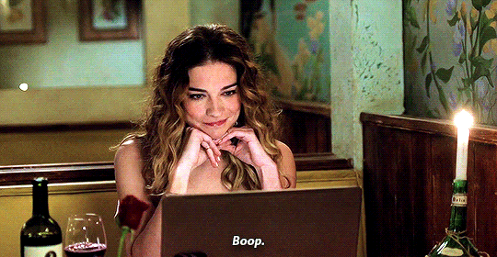
Falling In Love

Slide 30
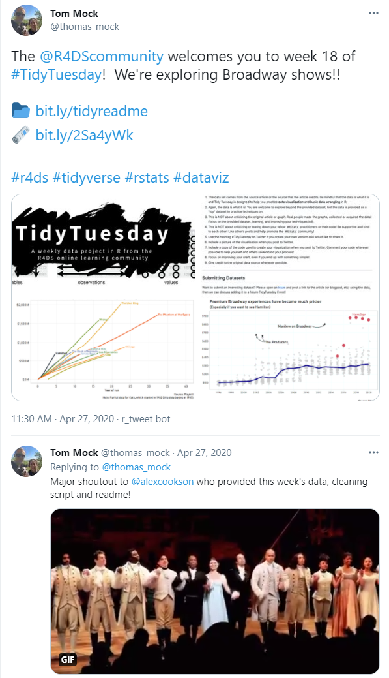
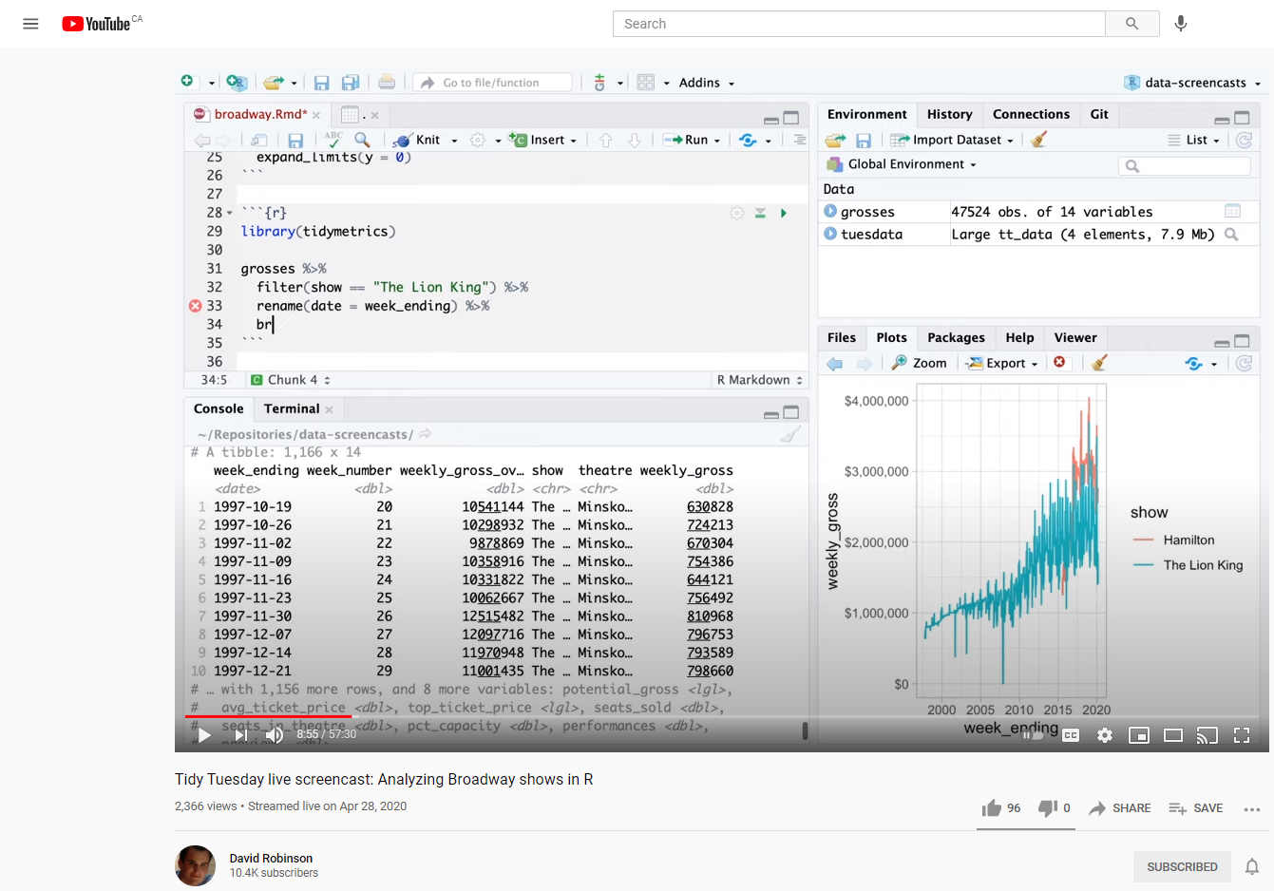

Falling In Love

Slide 31
Great Datasets: A Story
_

Slide 32
Great Datasets: A Story
—
—
^
ies
—
^
Many
_

Slide 33
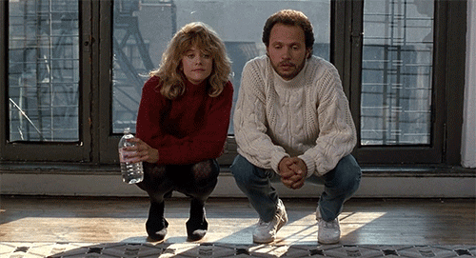
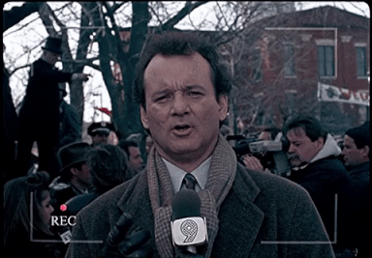
Love Story kept repeating itself

Slide 34
Love Story kept repeating itself
Japanese mascots (use Google Language API)
Sakura flowering (gganimate)
Fictional character personalities (Principal Component Analysis)
U.S. diplomatic gifts (parsing PDFs, natural language processing)

Slide 35
Love Story kept repeating itself
Japanese mascots (use Google Language API)

Slide 36
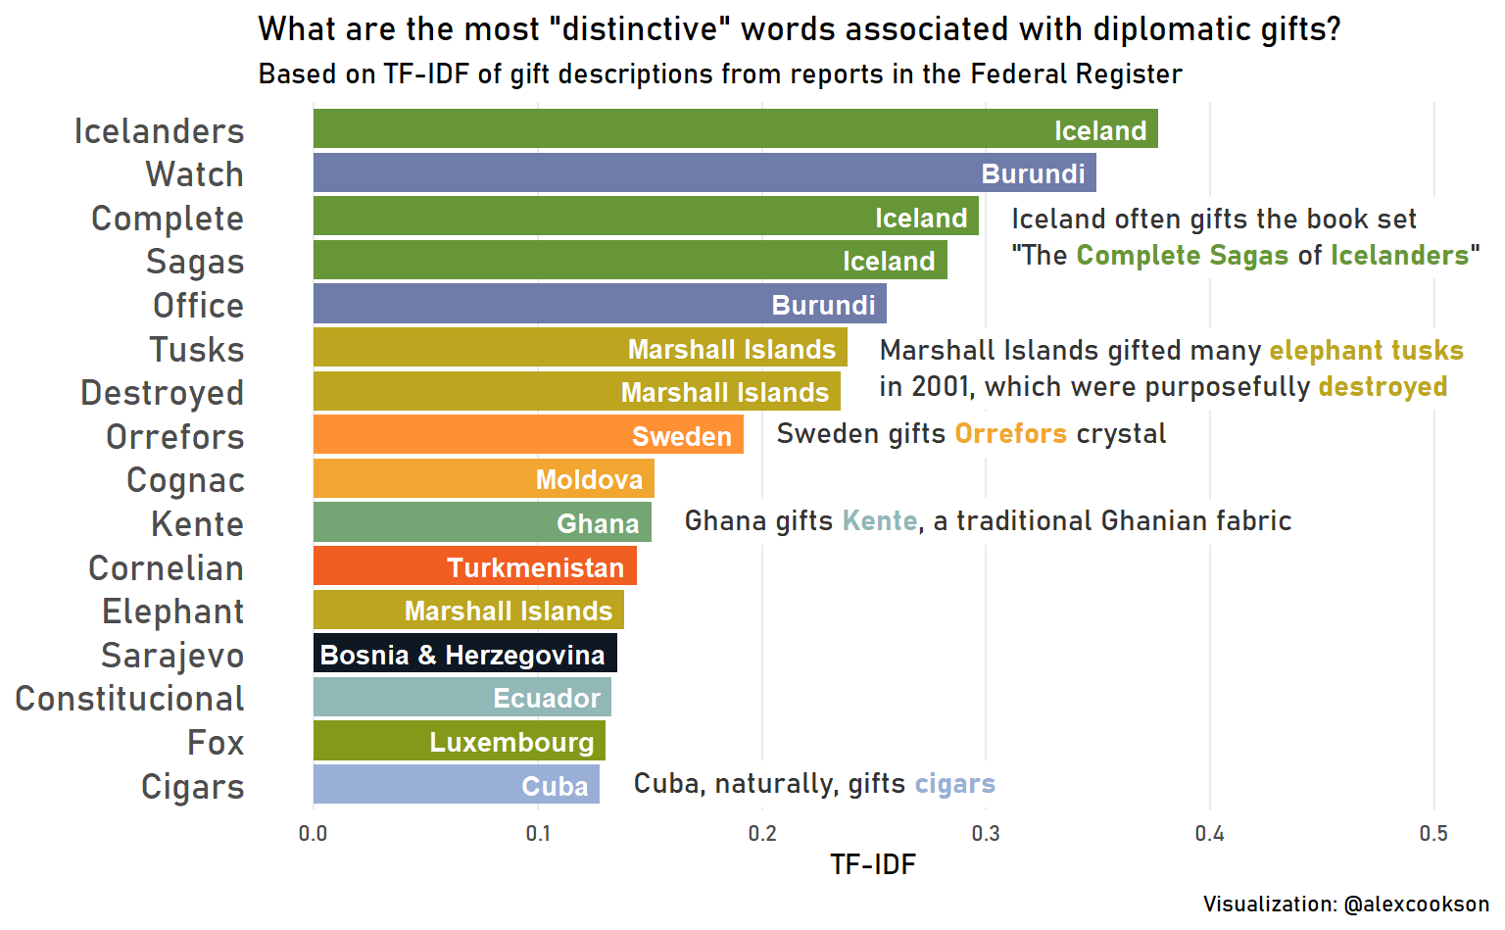
Love Story kept repeating itself
U.S. diplomatic gifts (parsing PDFs, natural language processing, ggtext)

Slide 37
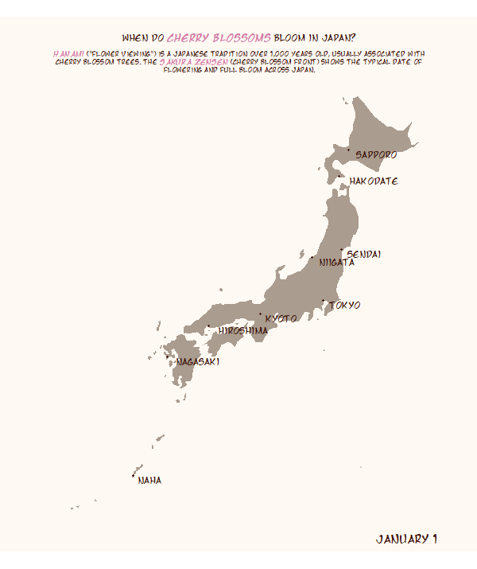
Love Story kept repeating itself
Sakura flowering (gganimate, adding custom images to ggplot))

Slide 38
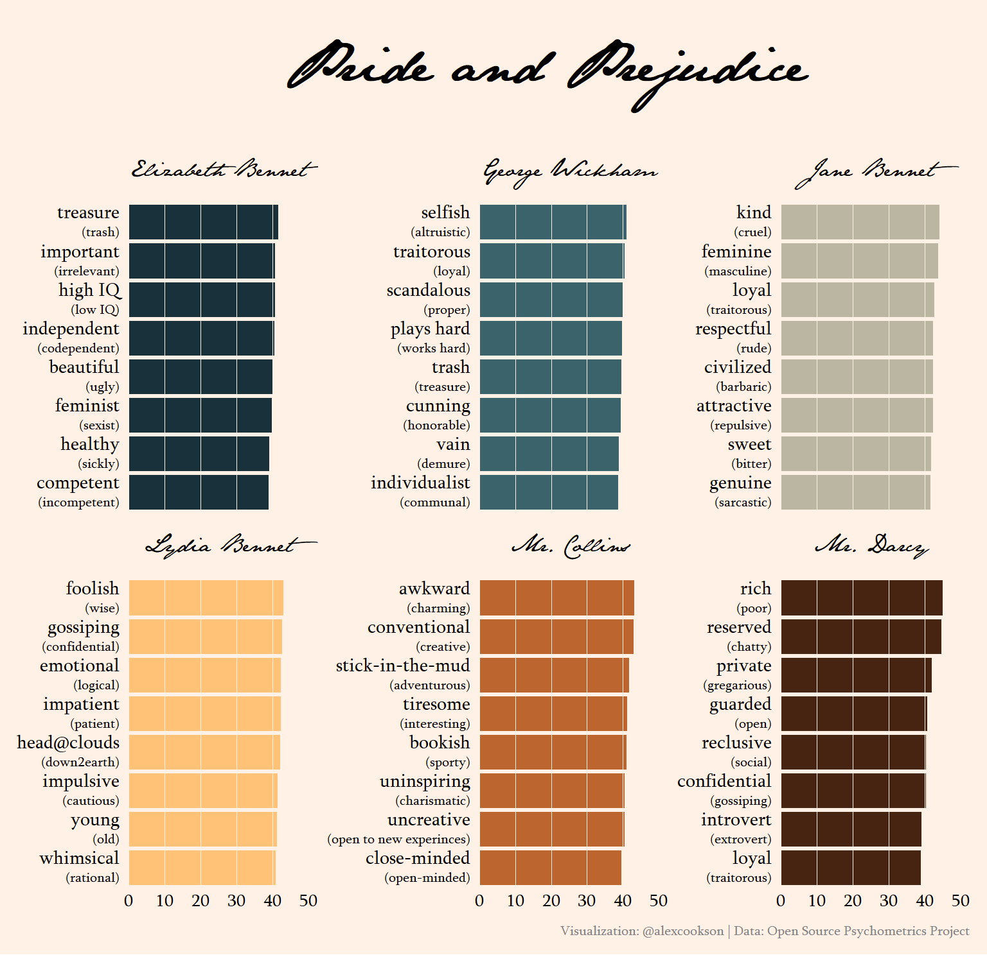
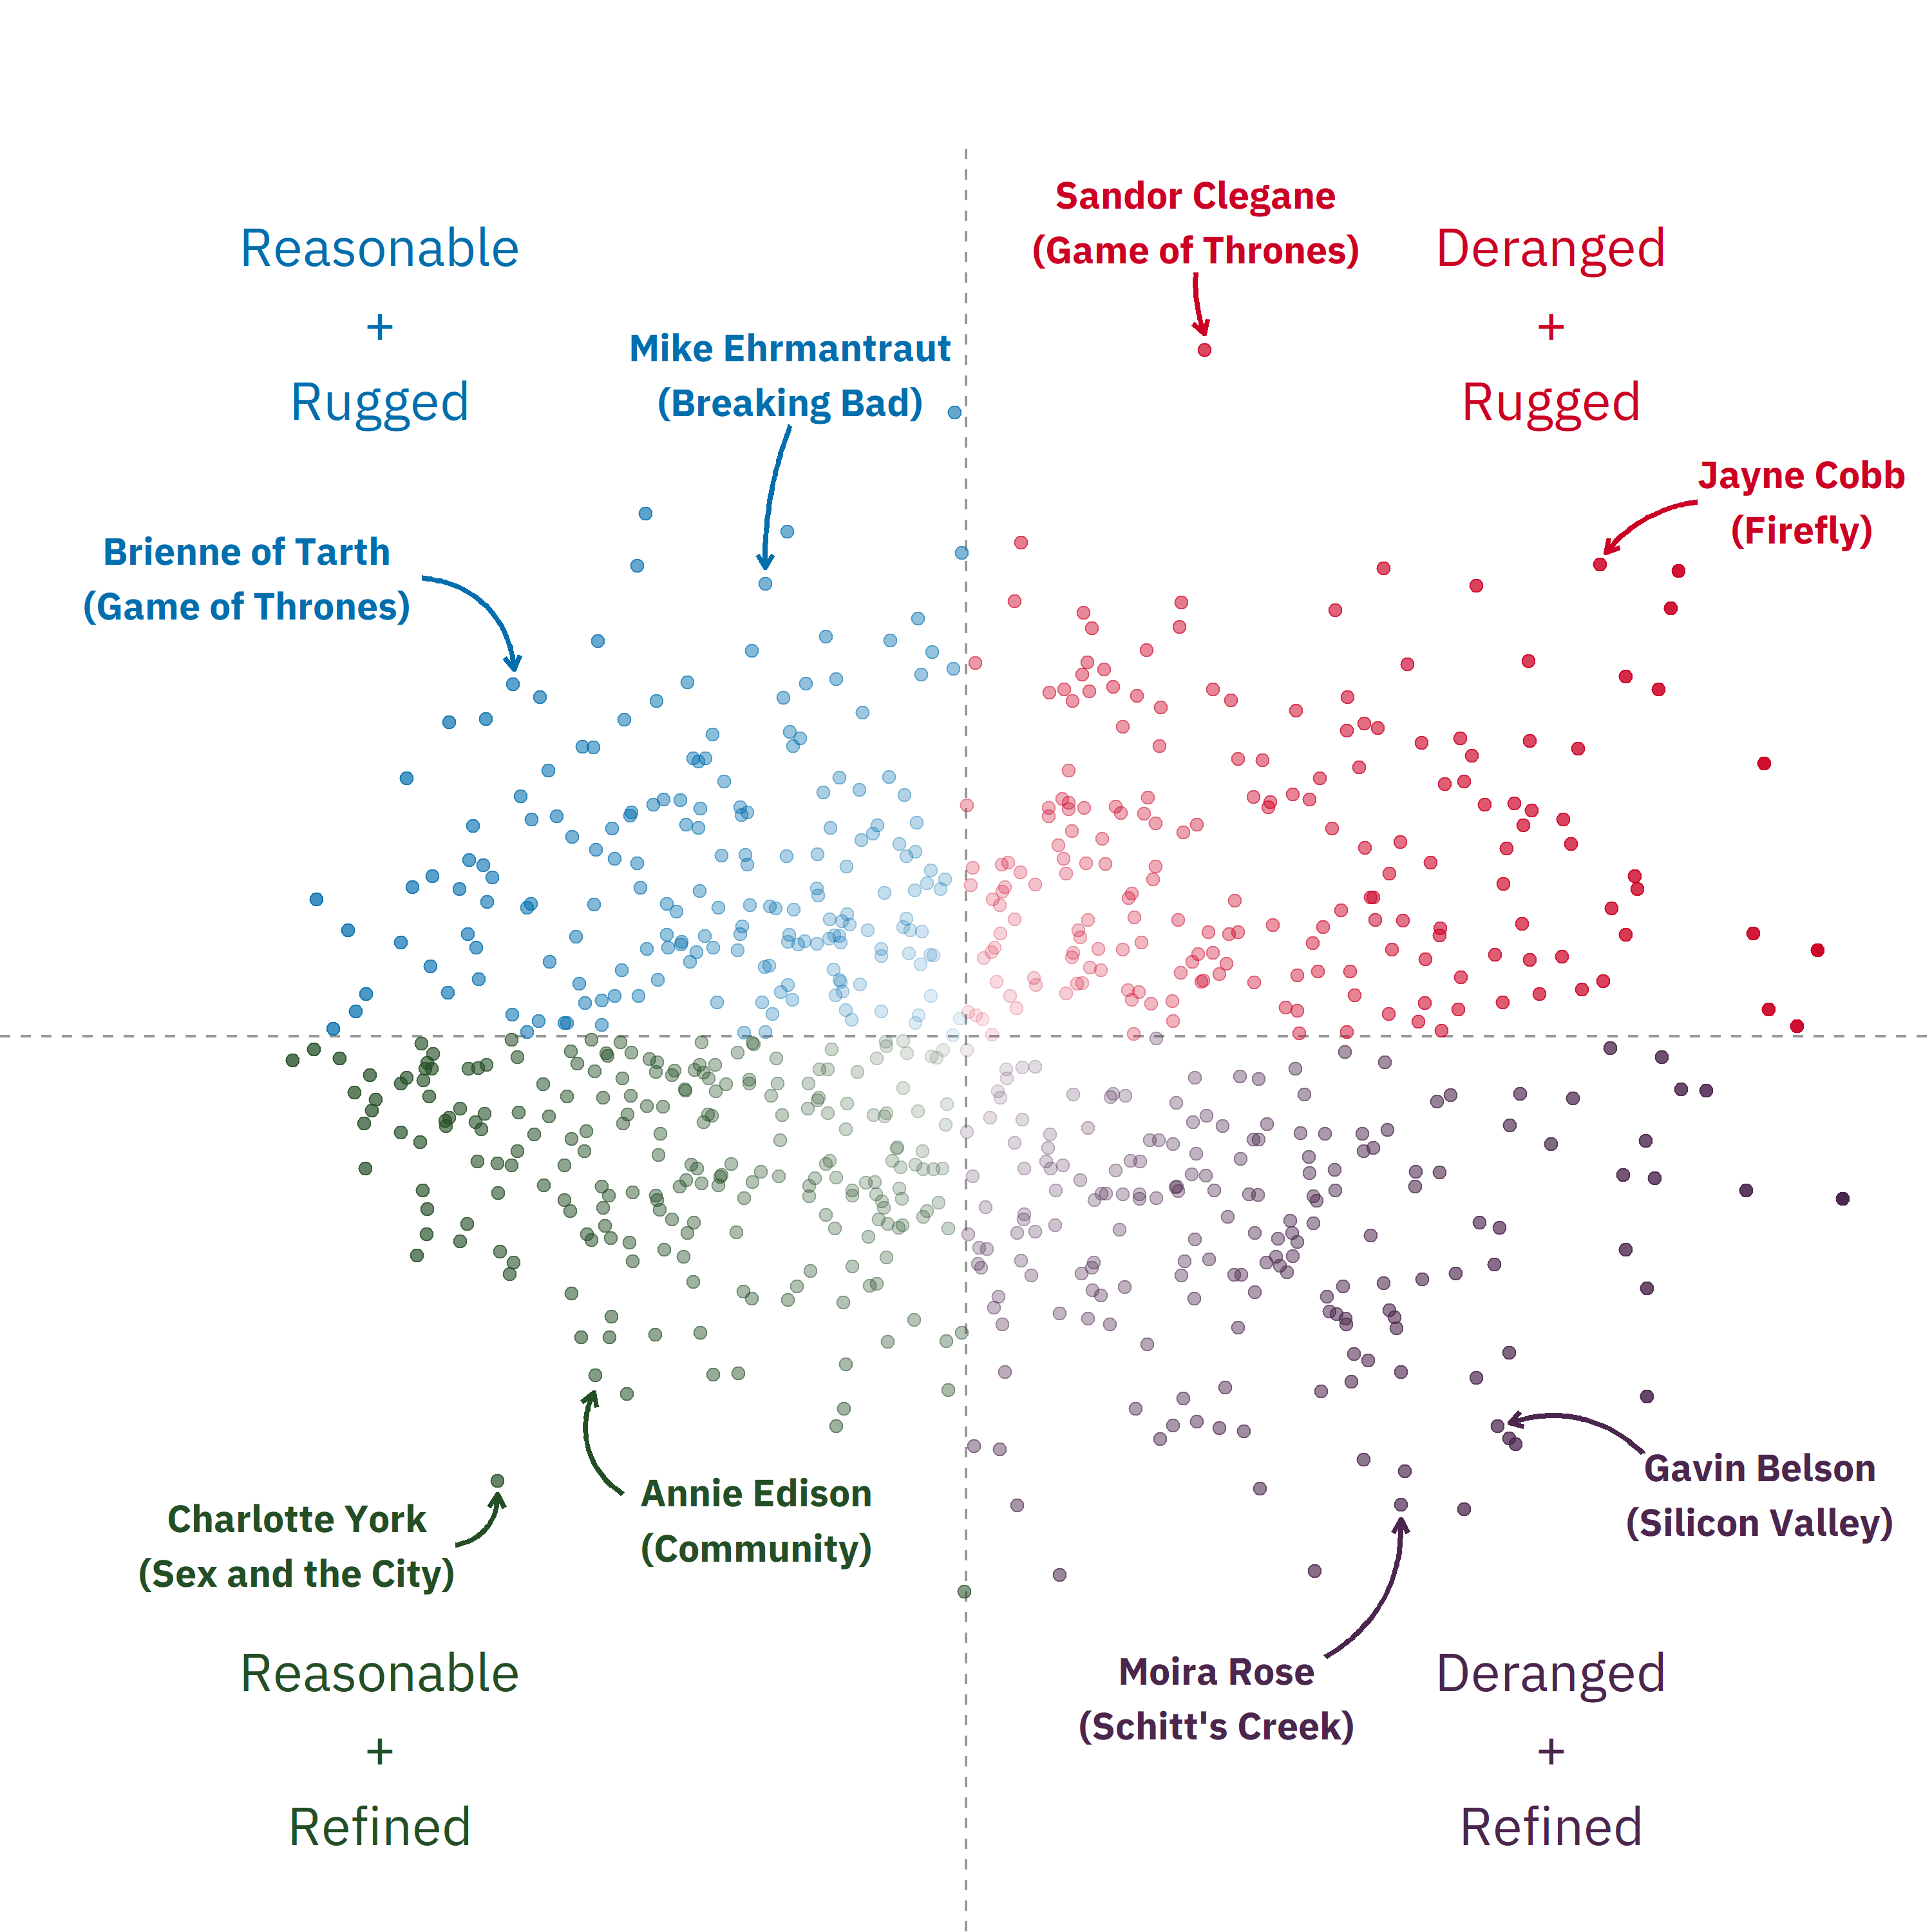
Love Story kept repeating itself
Fictional character personalities (Principal Component Analysis, tidymodels framework)

Slide 39
Great Datasets as a learning path
Typical learning path: identify outcome you want → find dataset → practice on dataset
Motivation comes from getting the outcome
Example: prediction of binary outcome → Titanic dataset → practice
Great dataset learning path: find dataset → identify outcome → practice on dataset
Motivation comes from inherent interest in the dataset
Example: Broadway grosses dataset → Web scraping / Data visualization

Slide 40
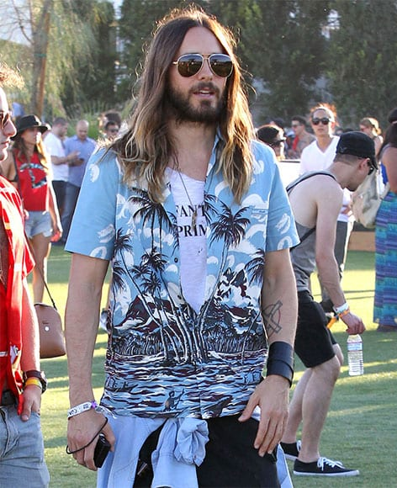

Great Datasets as a display of individuality
The datasets you work with and share can be a reflection of who you are

Slide 41
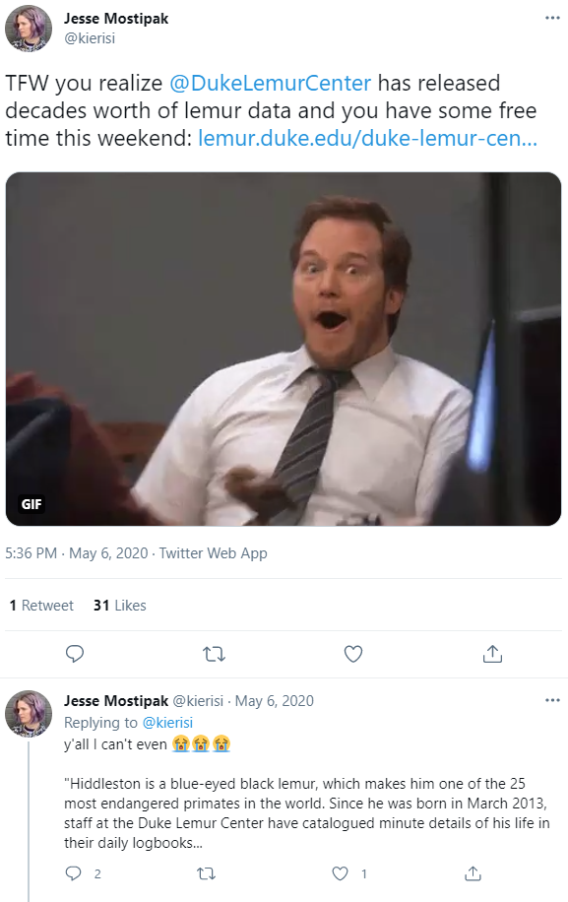
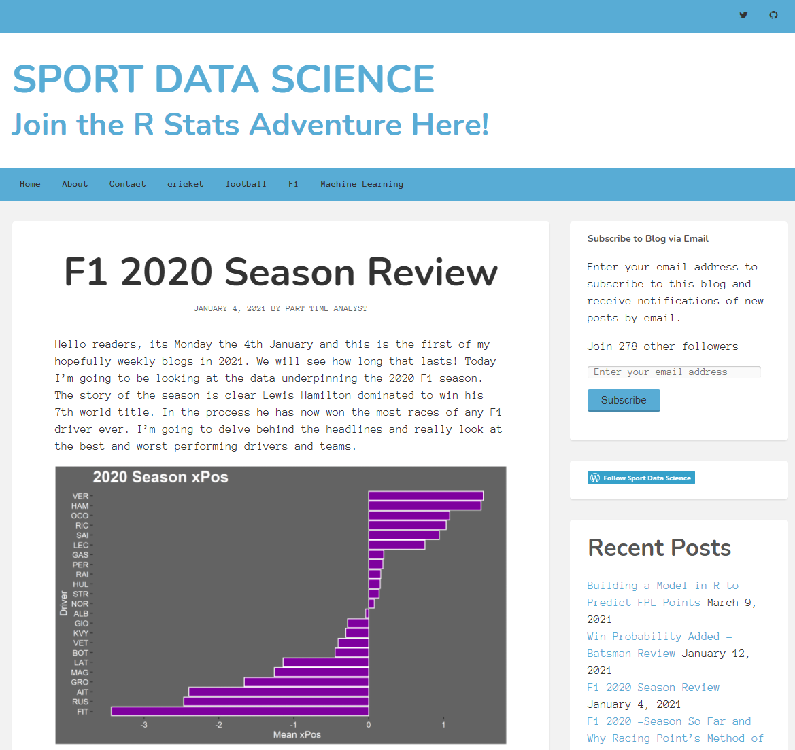
Great Datasets as a display of individuality

Slide 42

Great Datasets as giving back to the community
If you find something interesting, someone else will too
It feels good to be recognized/thanked for work you’ve done

Slide 43
Common Questions
Where can I find great datasets?
How do I start putting together my own datasets?

